Slide 1

Air Quality Forecasting(CO2 emissions)
Project P-143
Start Date: 15/08/2022
Mentor Name: Neha Gupta
Team Members
Alka Aswar
Ankita Phad
Priyanka Pagar
Rohit Banate
Mohit Shrimali

Slide 2
PROJECT FLOW
Business Problem
Load Dataset & Observe it
EDA And Visualization
Feature Selection
Model Deployment
Model Building
Train/Test Splitting the Data

Slide 3
Step 1 . Business Problem
Problem Statement
We have a dataset of previous 215 years from 2014, we need to analyze the dataset and considering various factors impacting the CO2 emissions.
Objective:
To forecast CO2 levels for an organization so that the organization can follow government norms with respect to CO2 emission levels.

Slide 4
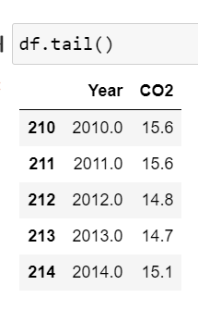
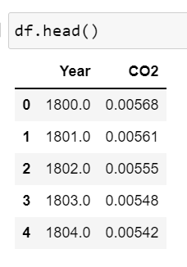
The Data
Step 2. Load Dataset & Observe it

Slide 5
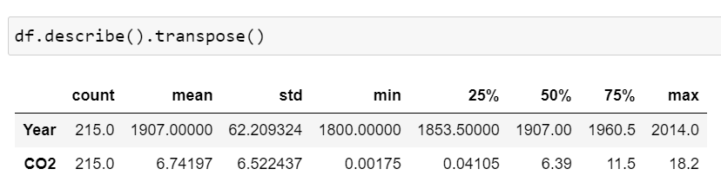
Step 3. Exploratory Data Analysis (EDA) and Feature Engineering
Data set details
1) Total Rows: 215
2) Total Columns: 2
3) Missing values: 0
4) Duplicate values: 0
5) Features Name: Year, CO2
6) Data Types:
Year – Datetime64
CO2 – Float
Data Description

Slide 6
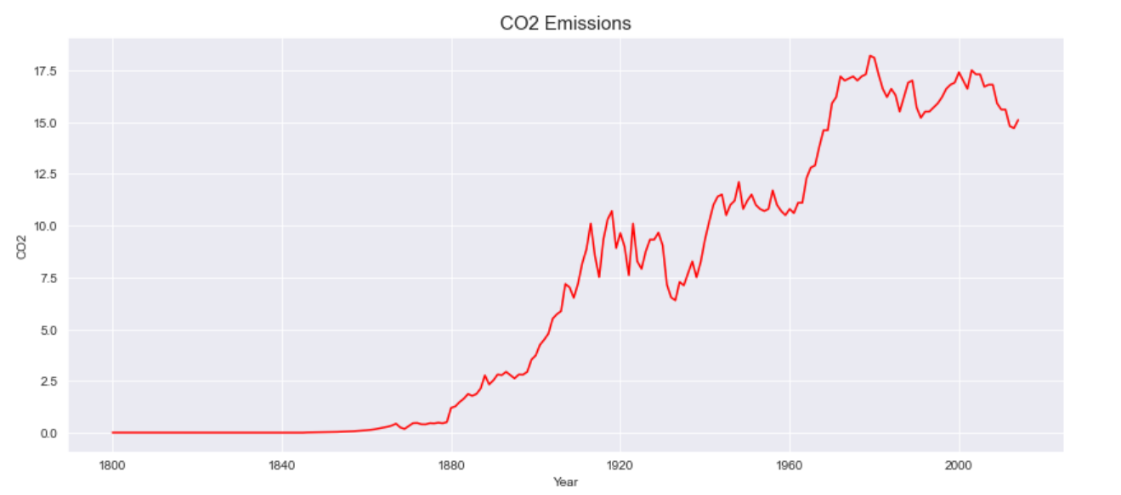
Exploratory Data Analysis (EDA)
The Line plot

Slide 7
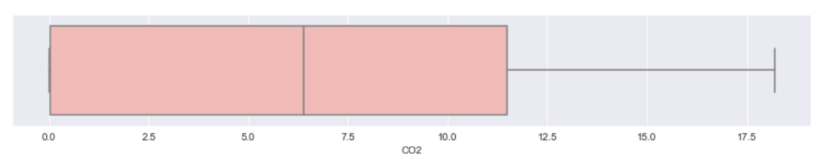
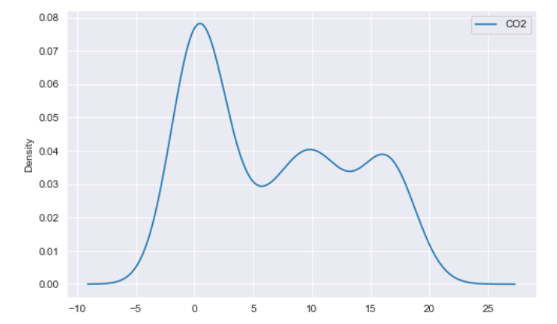
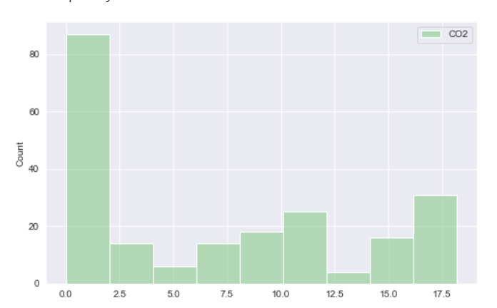
Exploratory Data Analysis (EDA)
Box plot
KDE
Histogram

Slide 8
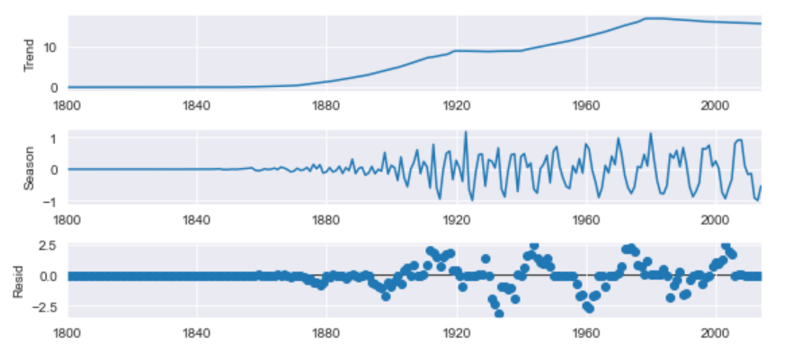
Exploratory Data Analysis (EDA)
Automatic Time series decomposition using STL
(Seasonal-Trend decomposition using LOESS)
STL uses LOESS (locally estimated scatterplot smoothing
Trend – upward trend
Seasonality – cyclic patterns
Noise – Random variation

Slide 9
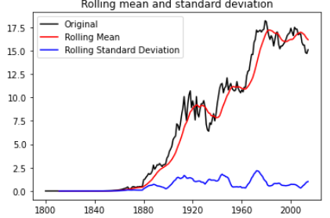
Exploratory Data Analysis (EDA)
Check for stationary

Slide 10
Exploratory Data Analysis (EDA)
Transform the non-stationary time series to stationary.
Apply First Differencing Technique
Differencing - a method of transforming a time series
Remove trend, seasonality, skewness.

Slide 11
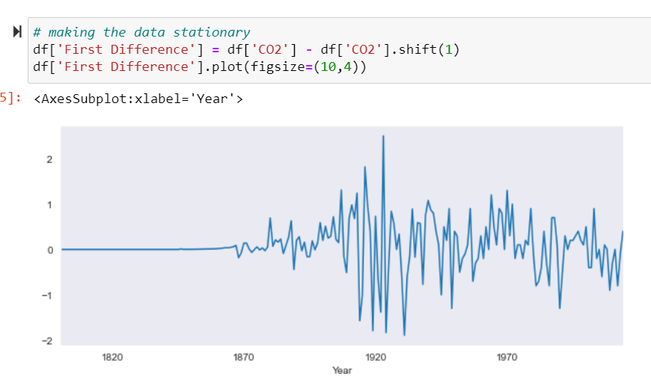
Step 4. Feature Transformation
Differencing

Slide 12
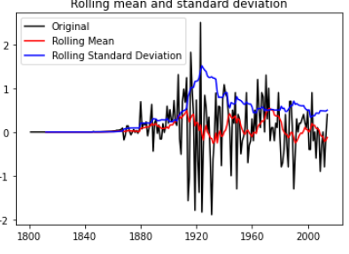
Feature Transformation
Before Applying First Differencing Data was not Stationary
After Applying First Differencing Data is Stationary

Slide 13
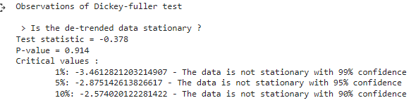
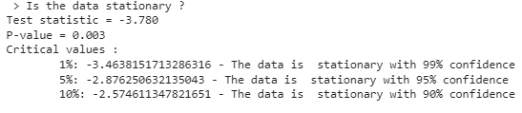
Augmented Dickey-fuller test Data is Stationary or not?
Before Applying First Differencing Data was not Stationary
Before Applying First Differencing Data was not Stationary

Slide 14
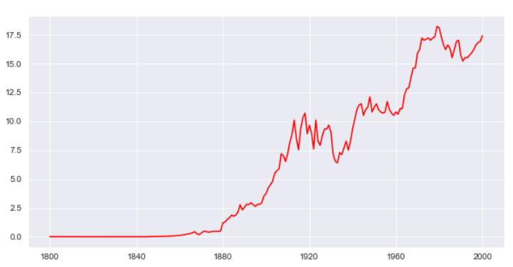
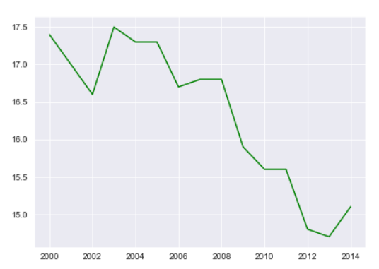
Step 5. Train / Test Splitting the Data
Train data
Test data

Slide 15
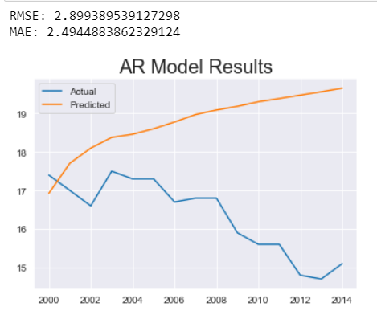
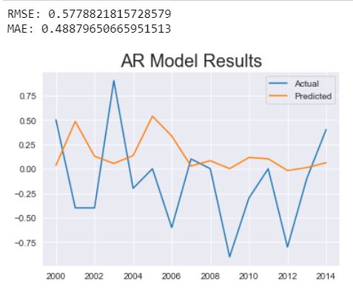
Step 6. Model Building
AR Model
AR Model- First Difference

Slide 16
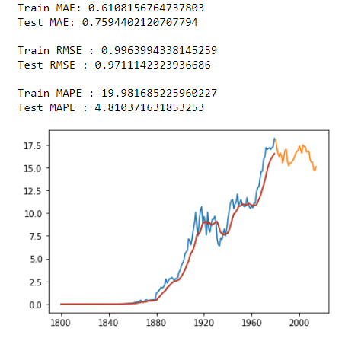
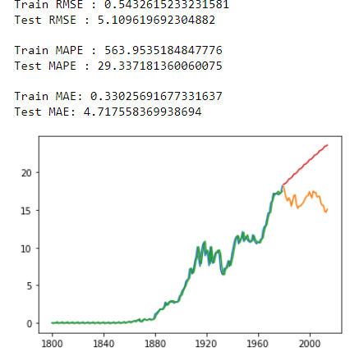
Models
Simple Exponential Method
Holt method(Additive trend & seasonality)

Slide 17
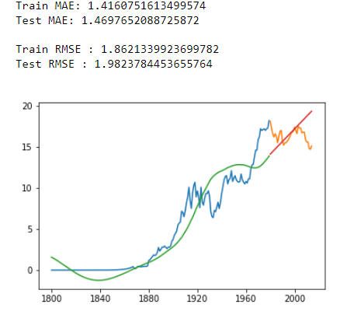
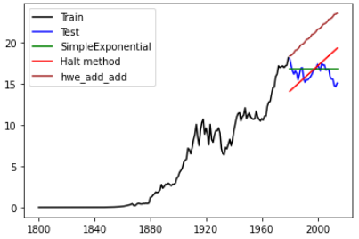
Models
Holt Method
Best fit model

Slide 18
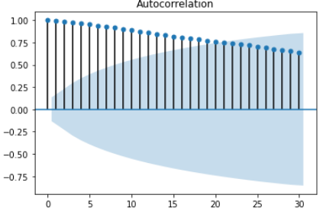
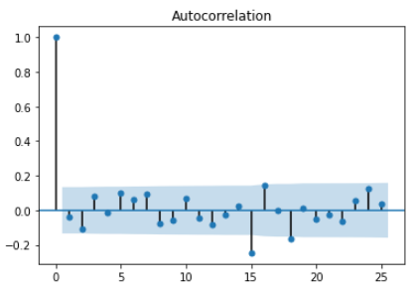
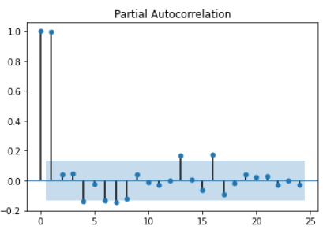
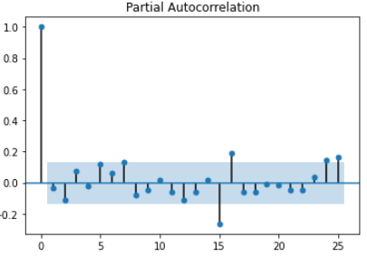
Models
First We will check p,d,q value for Arima Model . Using Acf and Pacf plot we can check for p,d,q and seasonality
Original Data
After First Differencing

Slide 19
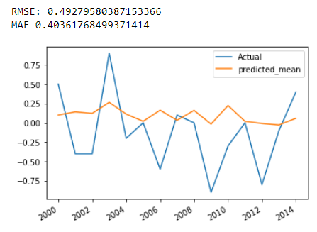
Models
Arima (p=7 , d=1 , q = 2)

Slide 20
Results
Sr No. | Model Name | RMSE Value | MAE Value
1 | AR | 0.5778 | 0.4887
2 | ARIMA | 0.4927 | 0.4036
3 | Simple Exponential | 0.9711 | 0.7594
4 | Holt Method | 1.4160 | 1.8621
5 | Holt Add Method | 5.1096 | 4.7175

Slide 21
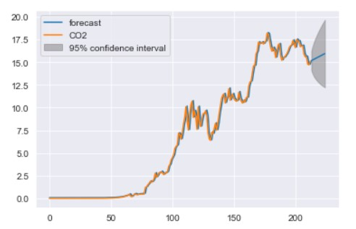
The final model-ARIMA
Forecast For Next 10 Years Using ARIMA with 95% confidence interval

Slide 22
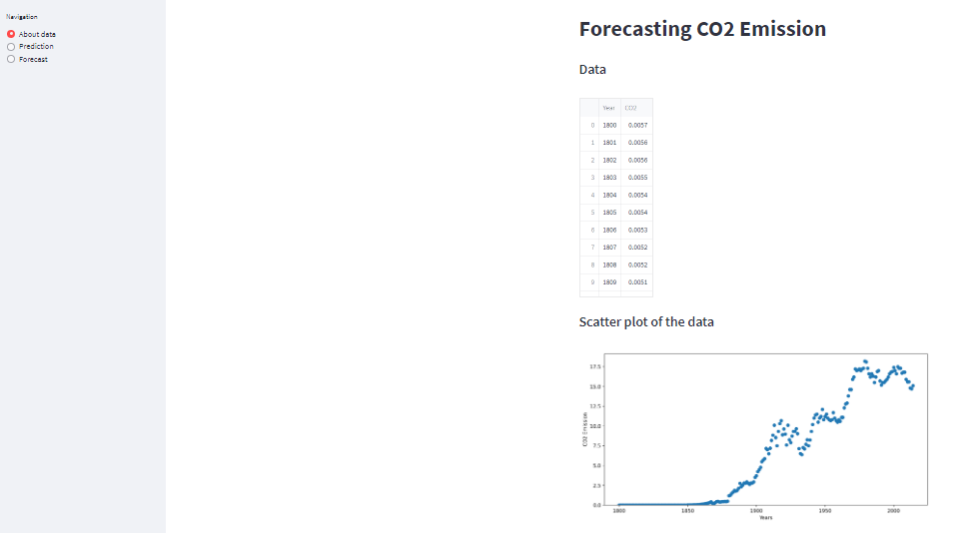
Step 7. Model Deployment

Slide 23
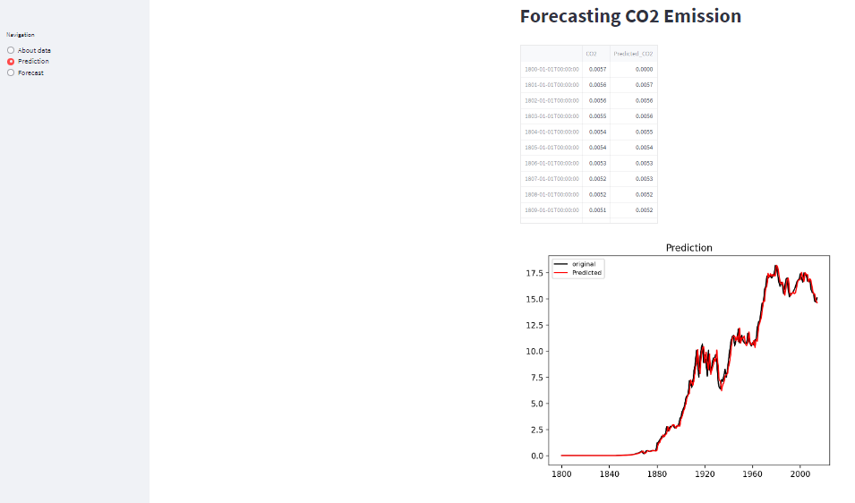
User Interface

Slide 24
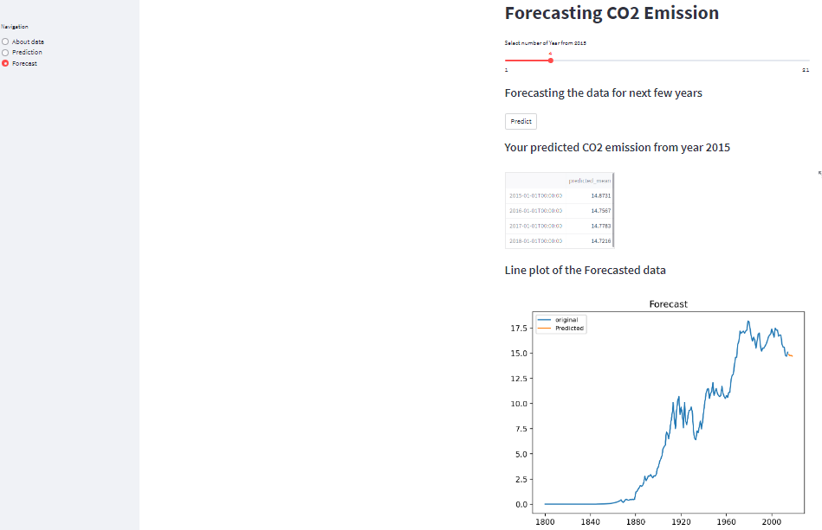
User Interface

Slide 25
Thank you !

